Slide 1
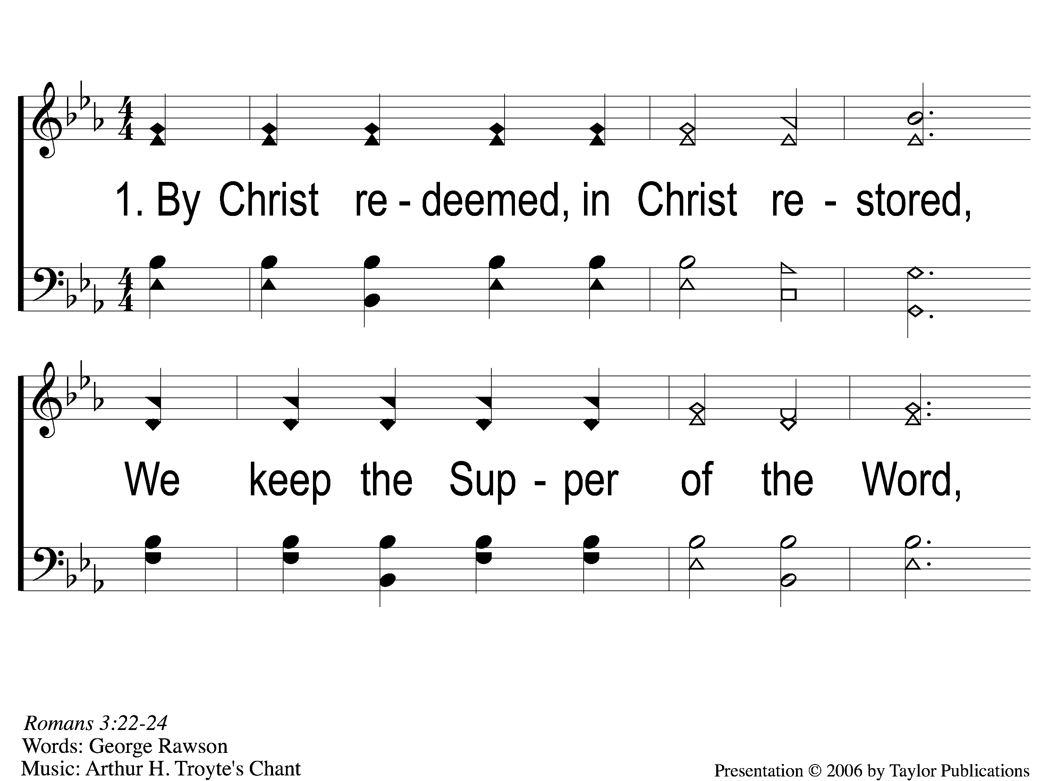
1-1 By Christ Redeemed
By Christ Redeemed
52

Slide 2
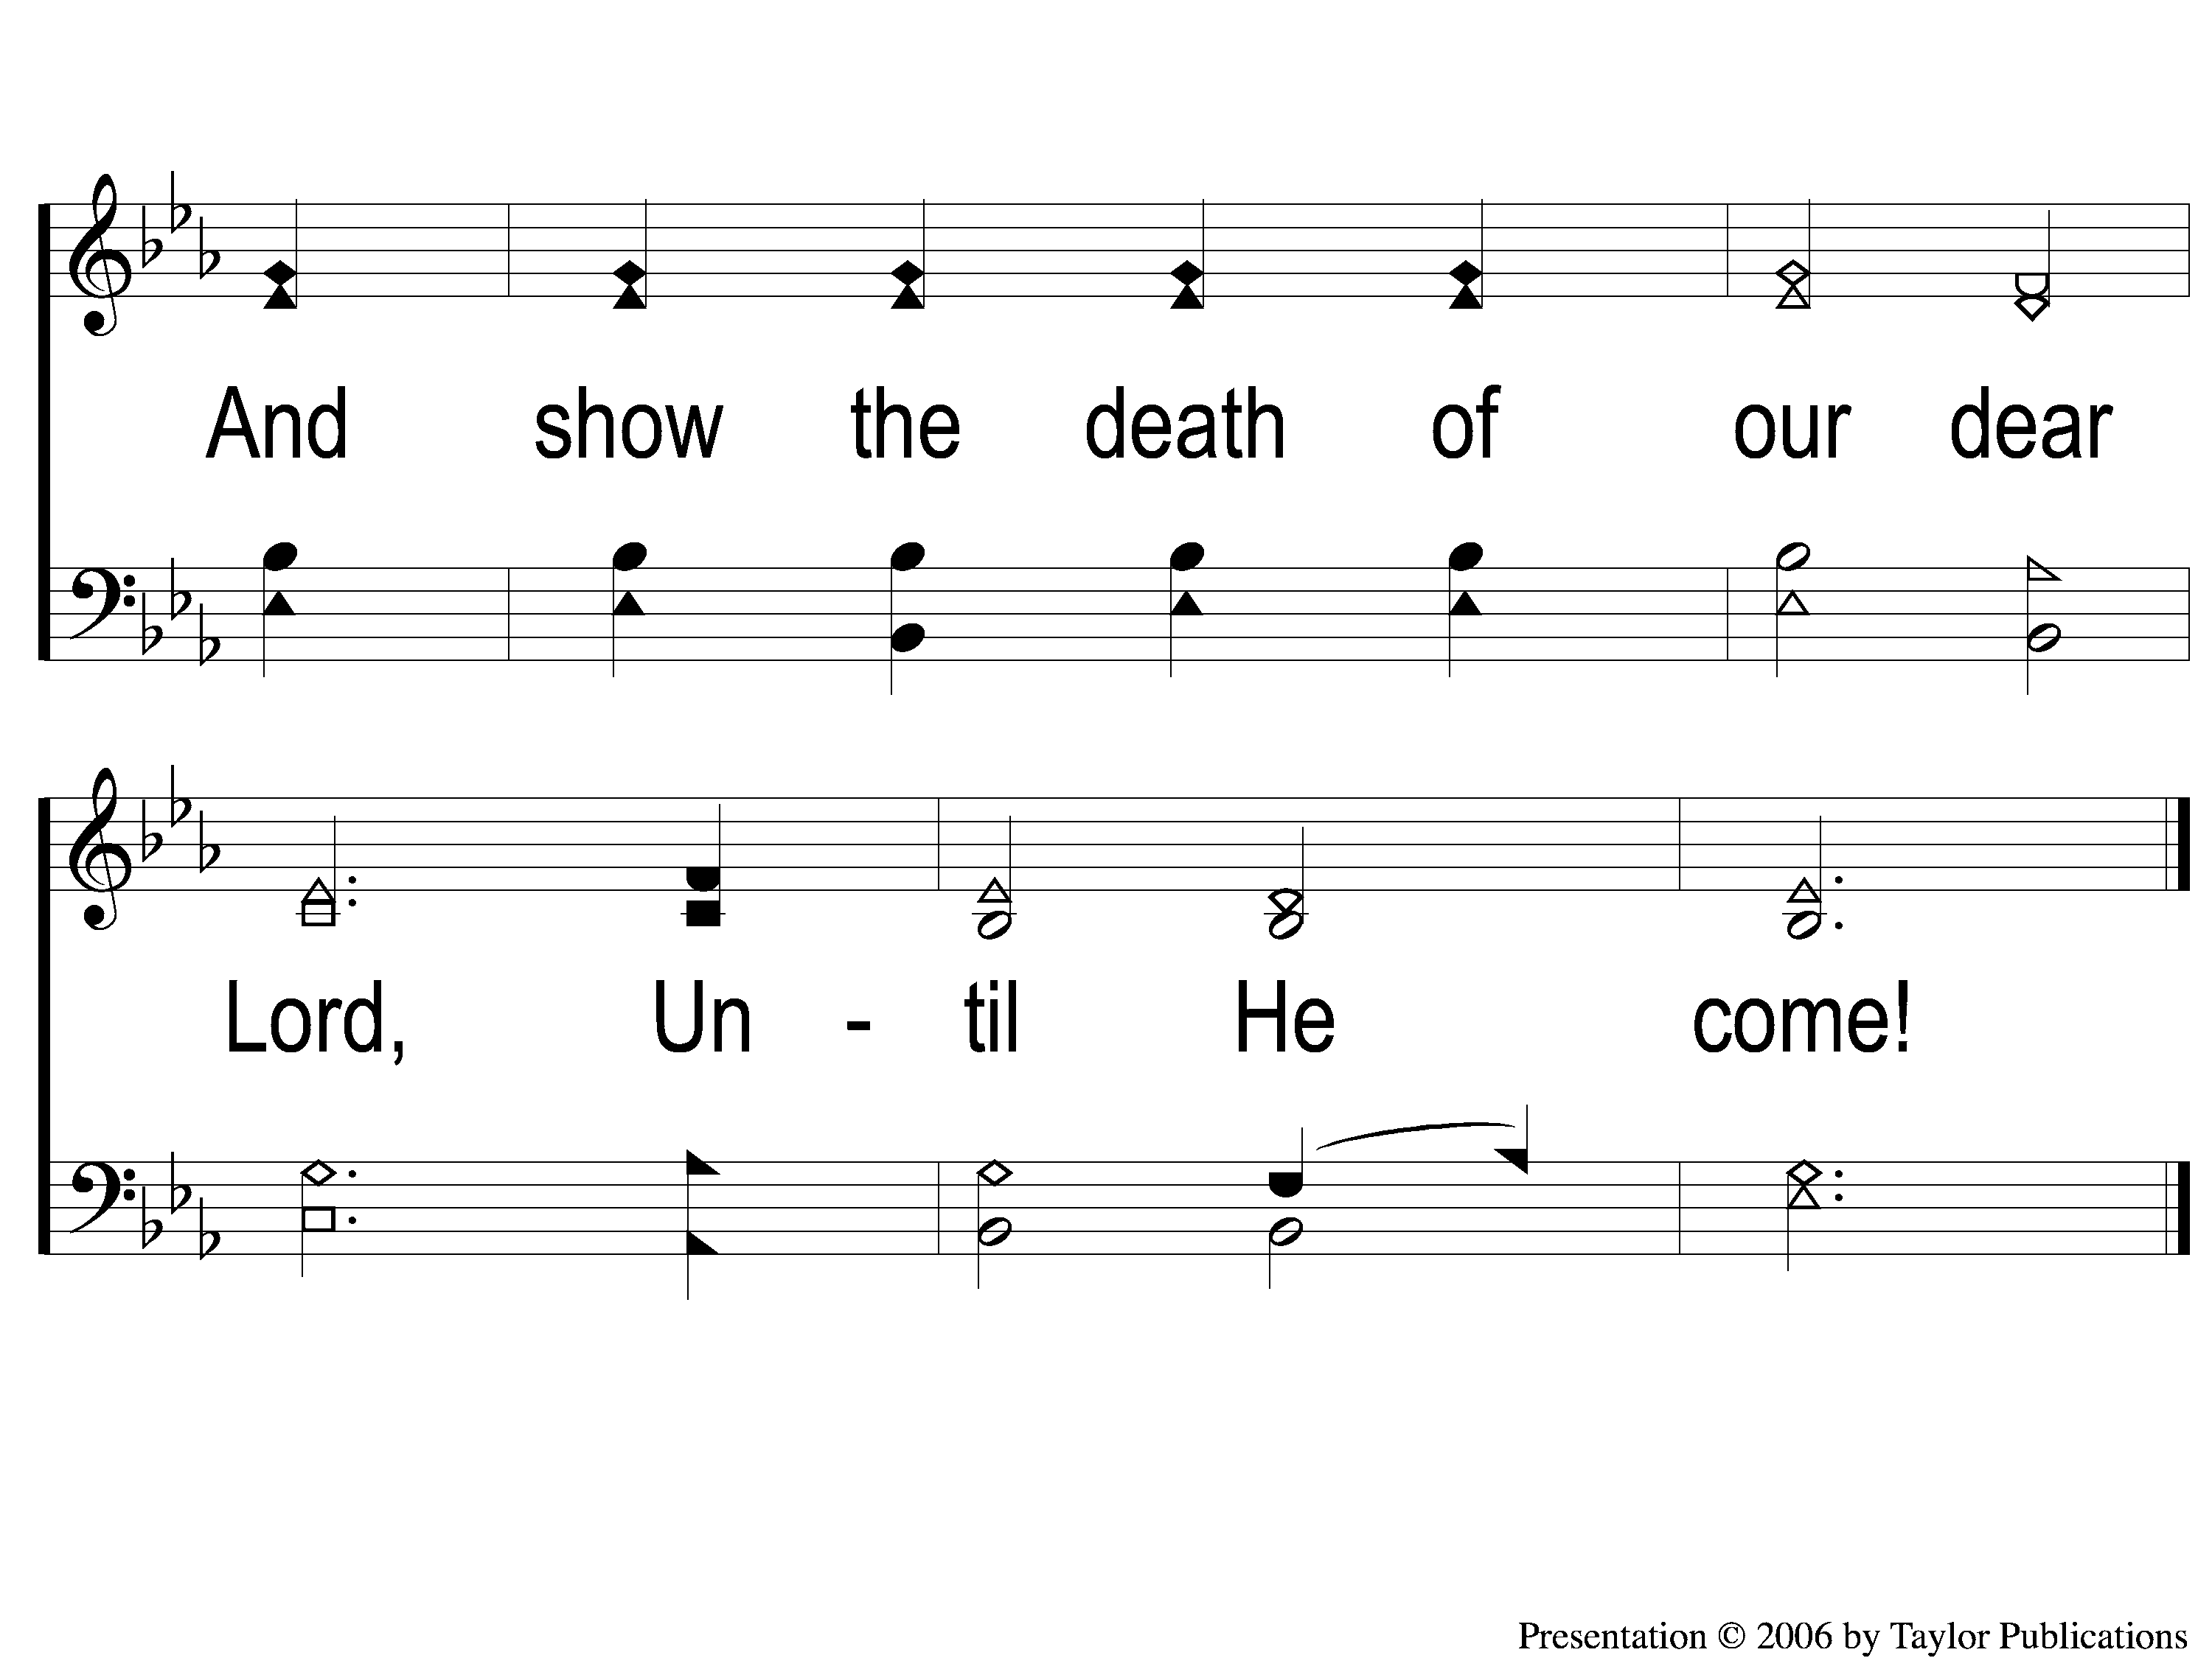
1-2 By Christ Redeemed
By Christ Redeemed
52

Slide 3
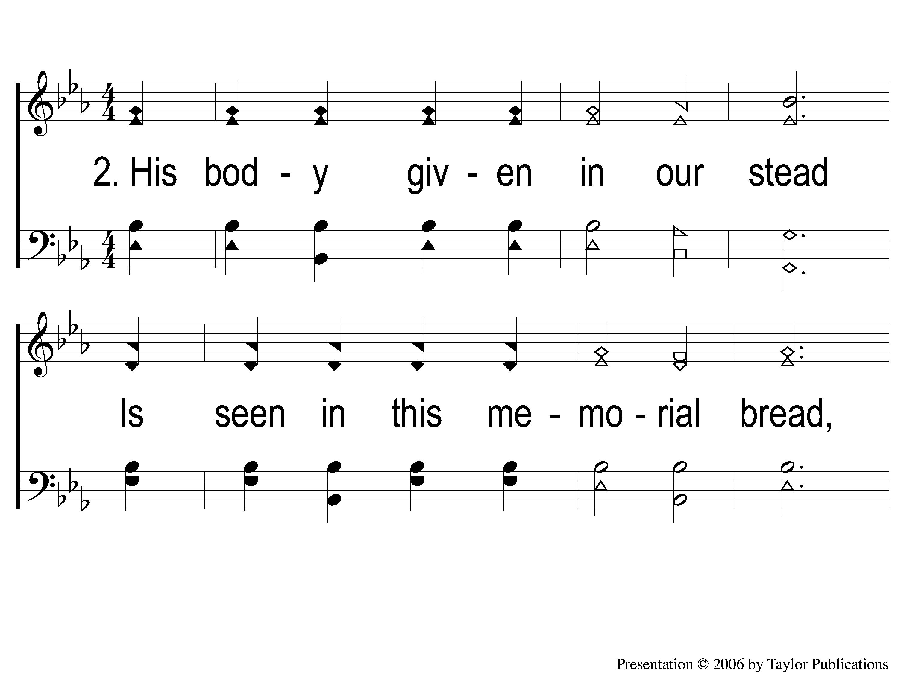
2-1 By Christ Redeemed
By Christ Redeemed
52

Slide 4
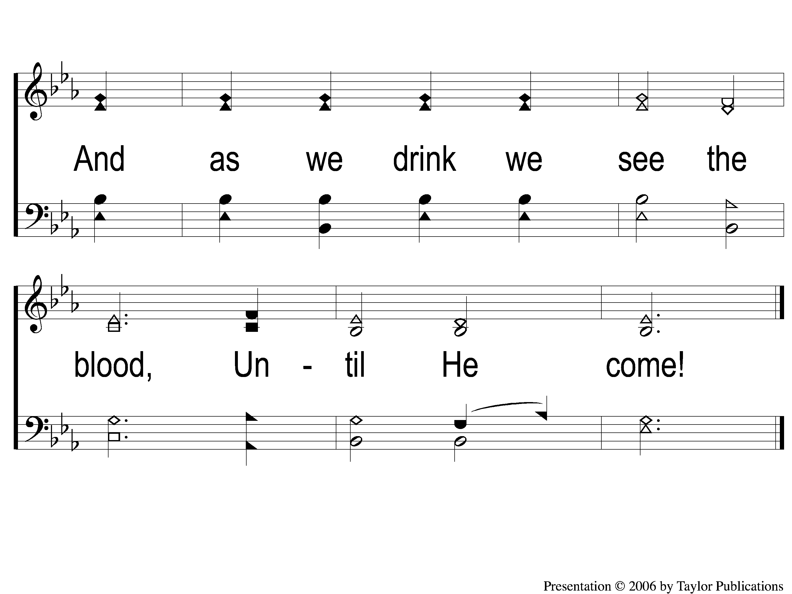
2-2 By Christ Redeemed
By Christ Redeemed
52

Slide 5
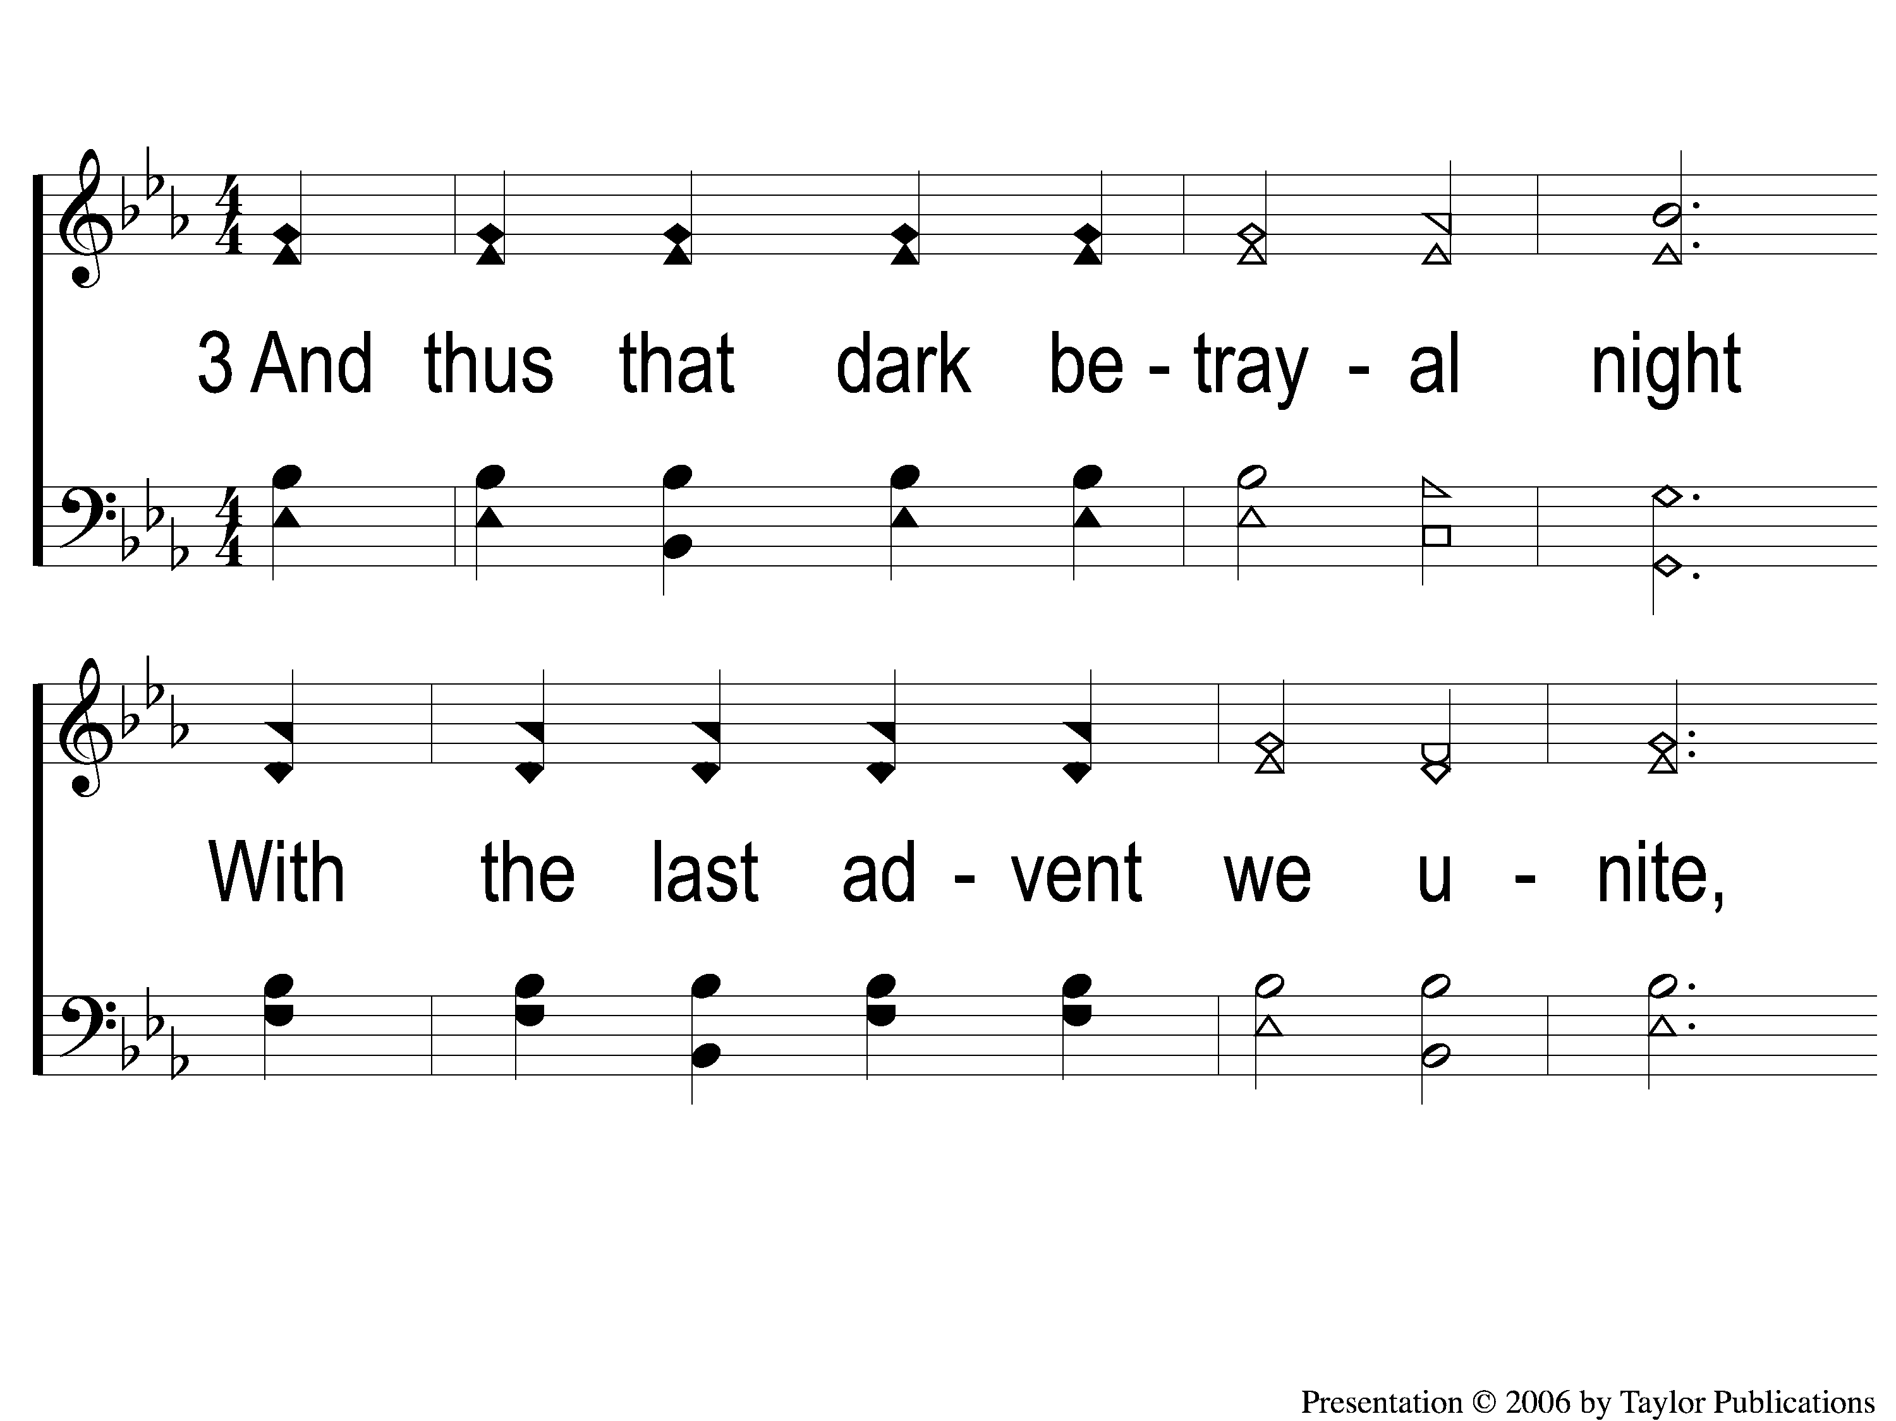
3-1 By Christ Redeemed
By Christ Redeemed
52

Slide 6
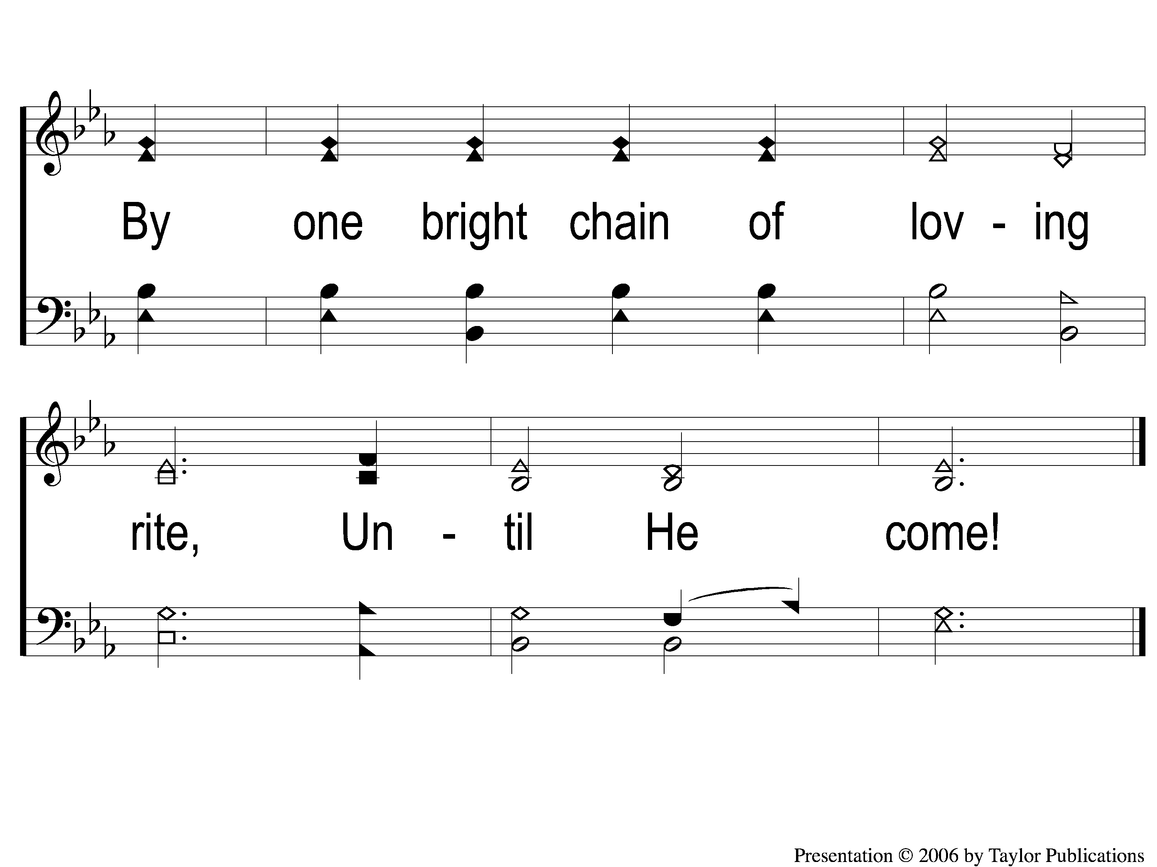
3-2 By Christ Redeemed
By Christ Redeemed
52

